Slide 1

SSC-Haematology
Dr.Ihsan Mardan Humod
MBCHB,MSc,FIBMS (Haematopathologist)

Slide 2


Slide 3
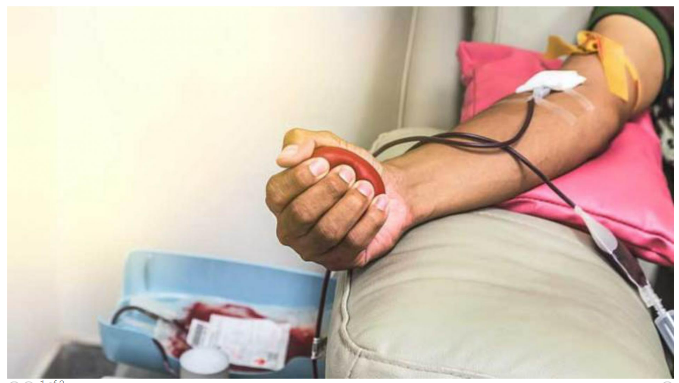

Slide 4
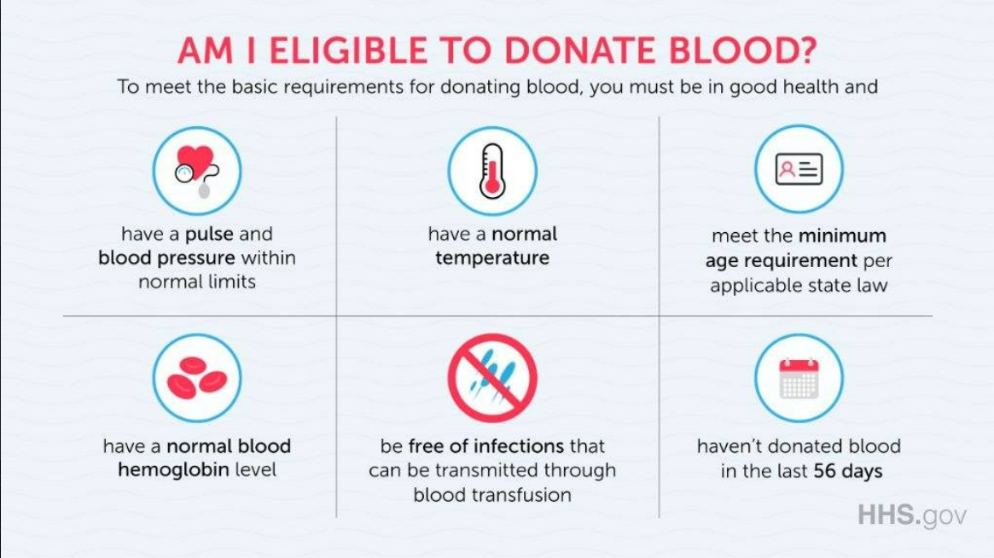

Slide 5
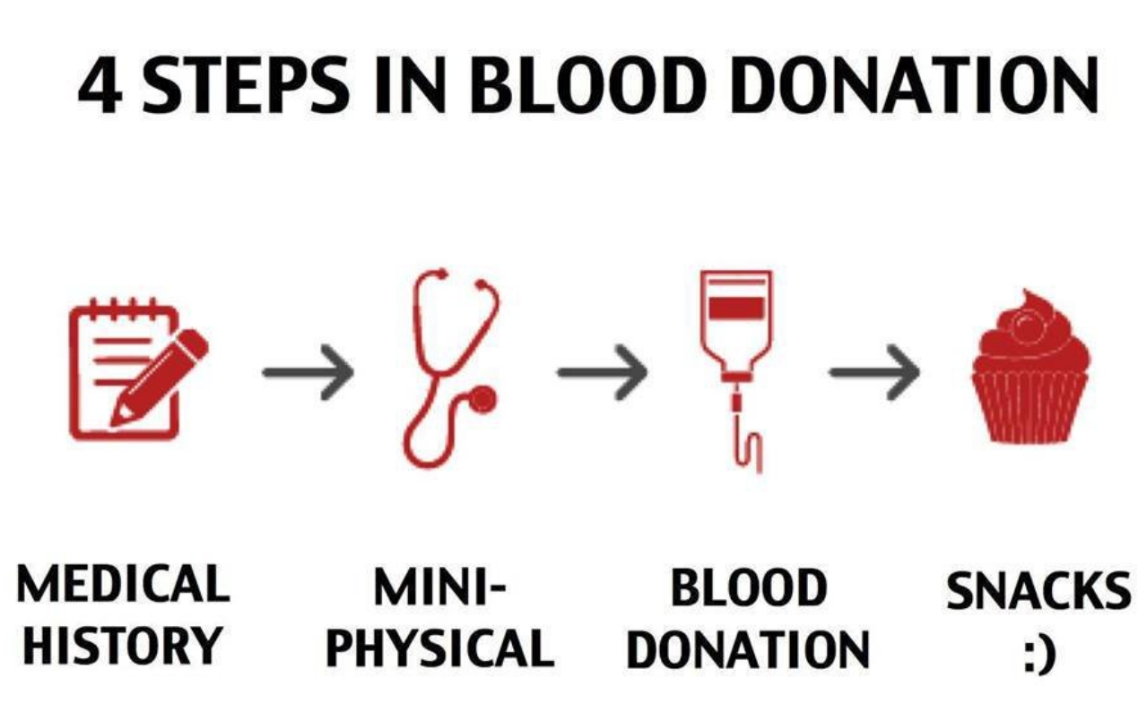
The Donation Process

Slide 6
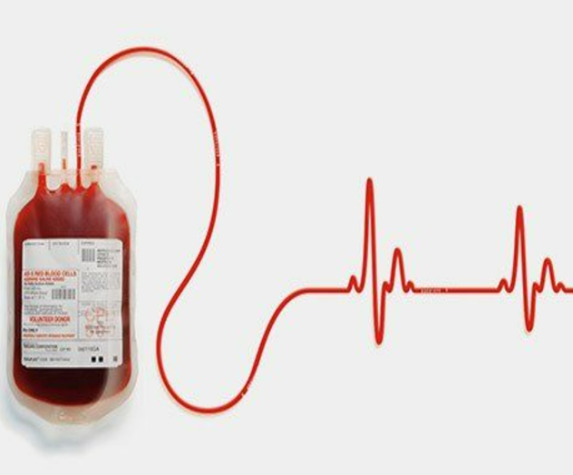
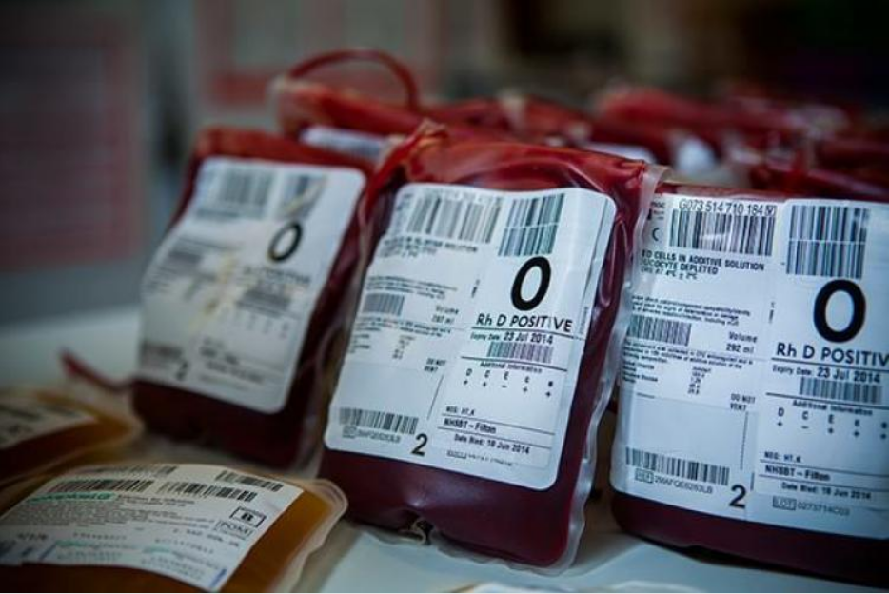
Each unit of whole blood collected contains approximately 450 mL of blood and 63 mL of anticoagulant preservative solution or approximately 500 mL of blood and 70 mL of anticoagulant-preservative solution.

Slide 7
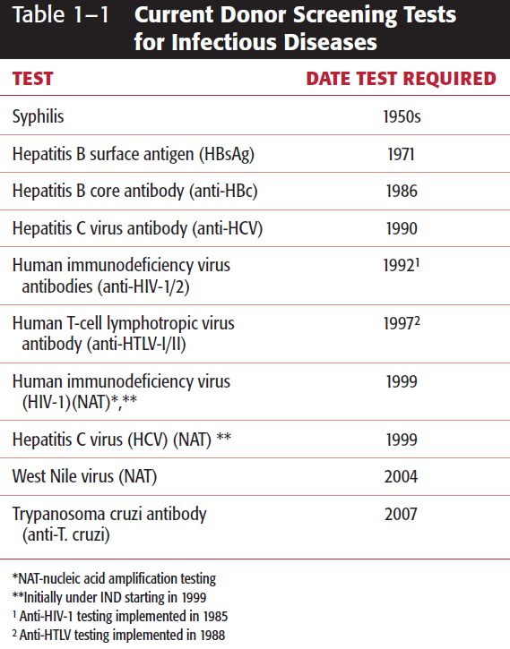
As of 2011, samples from donors of each unit of donated blood are tested by 10 screening tests for infectious diseases markers.

Slide 8
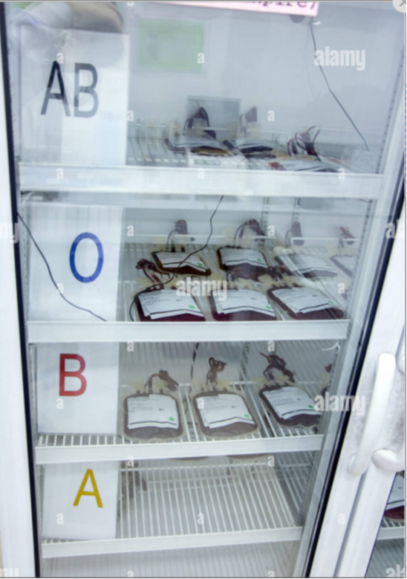
RBC Preservation
The FDA requires an average 24-hour post-transfusion RBC survival of more than 75%.
In addition, the FDA mandates that red cell integrity be maintained throughout the shelf-life of the stored RBCs. This is assessed as free hemoglobin less than 1% of total hemoglobin.

Slide 9
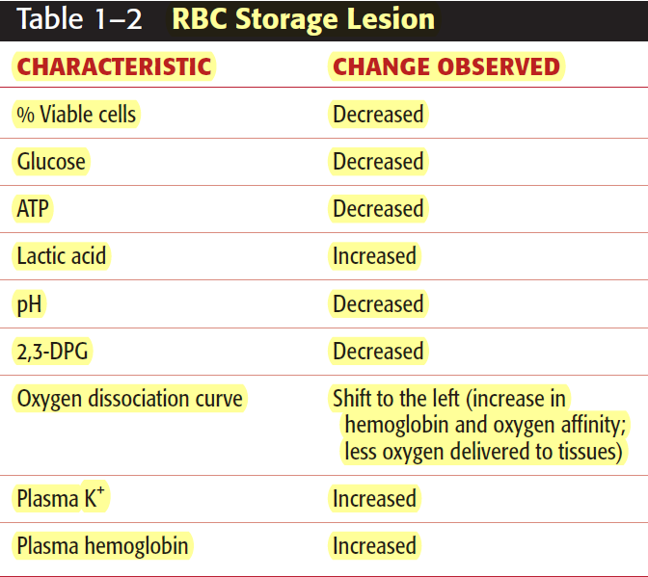
Blood is stored in the liquid state between 1°C and 6°C. The loss of RBC viability has been correlated with the lesion of storage.

Slide 10
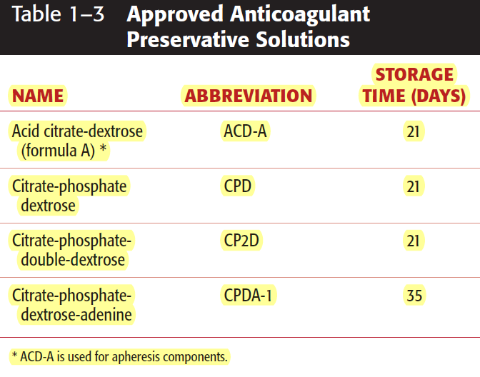

Slide 11
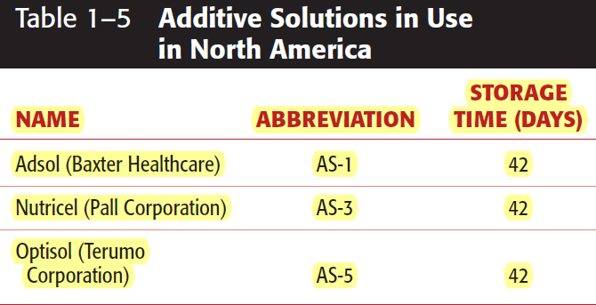

Slide 12
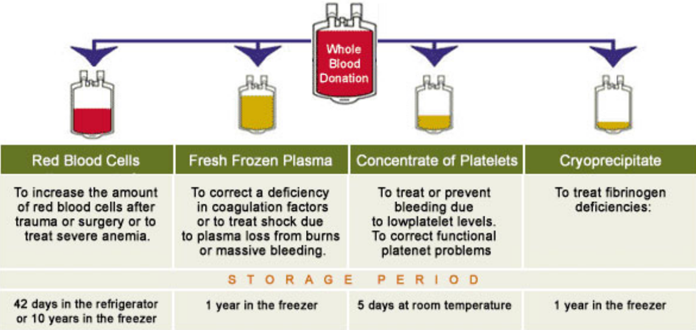
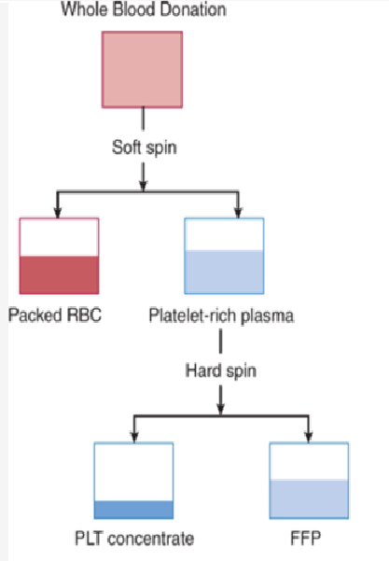
Separation of blood components

Slide 13
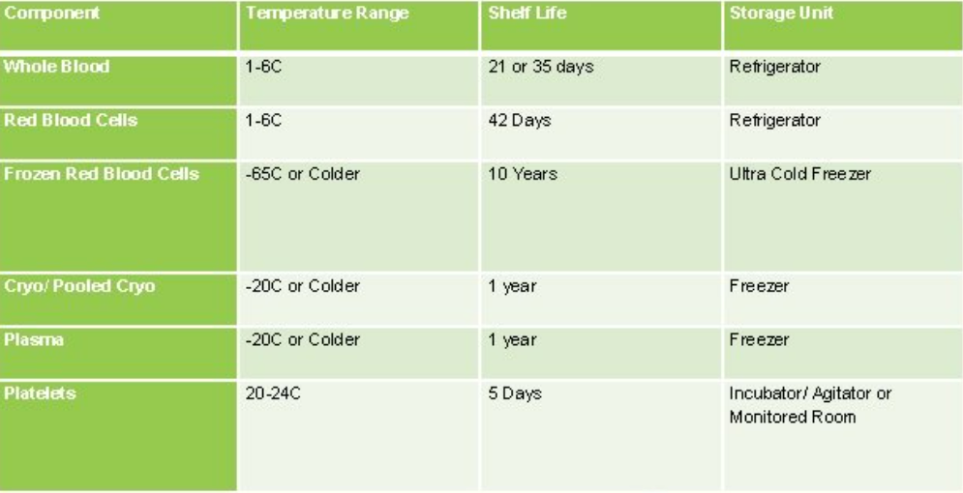

Slide 14
Platelet Preservation
The two main reasons for the 5-day shelf-life for platelets is bacterial contamination at incubation of 22°C and the loss of platelet quality during storage (known as the platelet storage lesion)

Slide 15
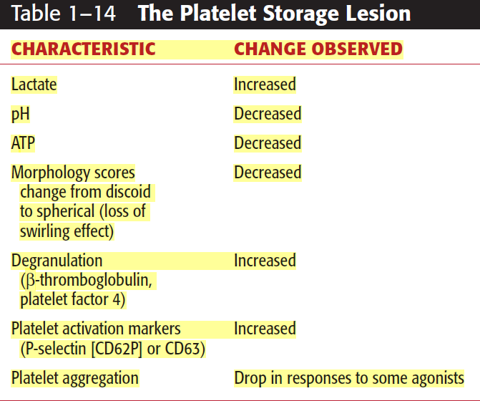

Slide 16
Platelet Preservation
A platelet concentrate (usually 4 to 6) should contain a minimum of 5.5*10¹⁰ platelets in a volume routinely between 45 and 65 mL.

Slide 17
Apheresis components contain 4 to 6 times as many platelets as a PC prepared from whole blood. They should contain a minimum of 3.0*10¹¹ platelets (in 90% of the sampled units).

Slide 18
Antiglobulin Test (Coombs’ Test)
The DAT detects in vivo sensitization of RBCs with IgG or complement components. Clinical conditions that can result in a positive DAT include HDN, HTR, and AIHA.
The IAT detects in vitro sensitization of RBCs and can be applied to compatibility testing, antibody screen, antibody identification, RBC phenotyping, and titration studies.

Slide 20
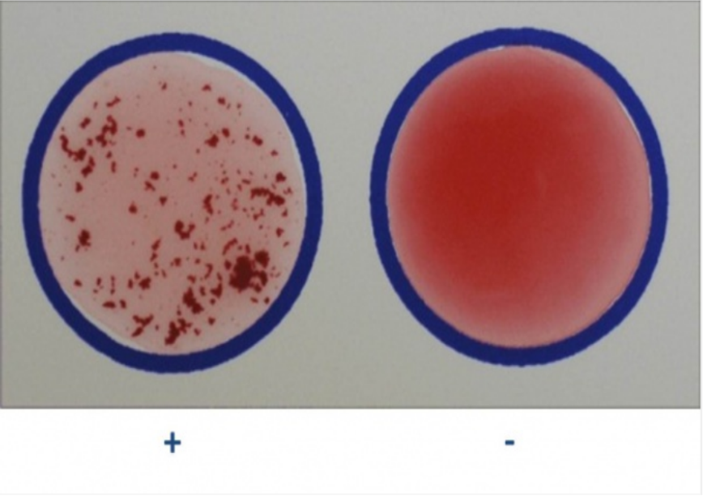

Slide 21
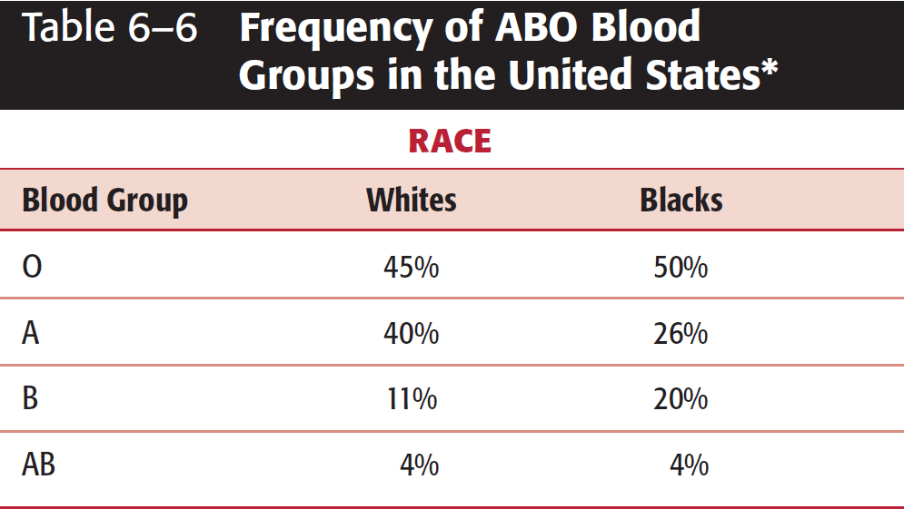
ABO Blood Group System

Slide 22
Forward grouping (front type) is defined as using known sources of commercial antisera (anti-A, anti-B) to detect antigens on an individual’s RBCs.

Slide 23
Reverse grouping (back type) is defined as detecting ABO antibodies in the patient’s serum by using known reagent RBCs, namely A1 and B cells.

Slide 24
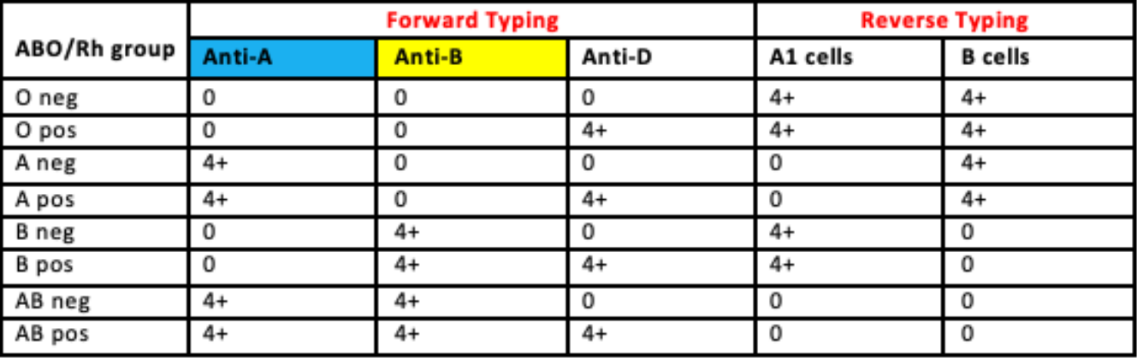

Slide 25
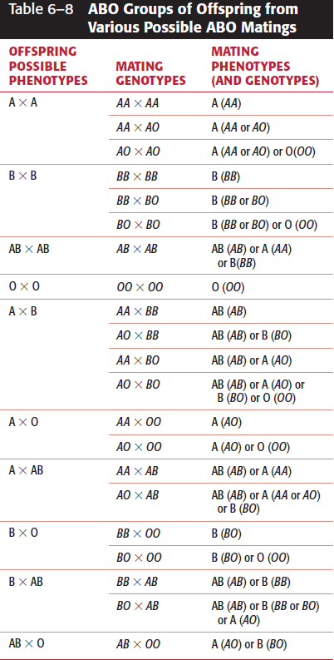

Slide 26
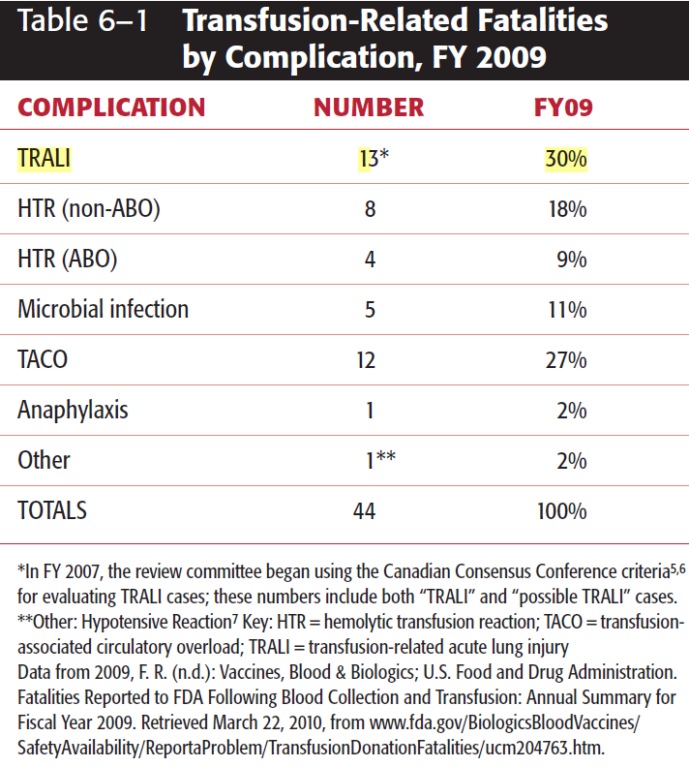

Slide 27
The Rh Blood Group System
The Rh antibody was so named on the basis of antibody production by guinea pigs and rabbits when transfused with rhesus monkey RBCs.
Historically, Rh was a primary cause of HDFN, erythroblastosis fetalis, and a significant cause of hemolytic transfusion reactions.

Slide 30
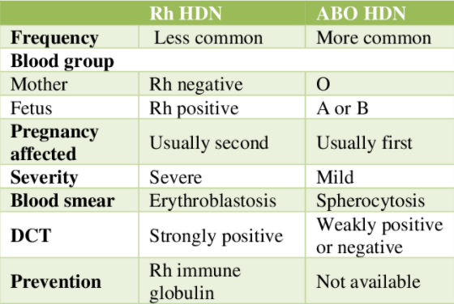

Slide 34
Thank you

